Slide 1
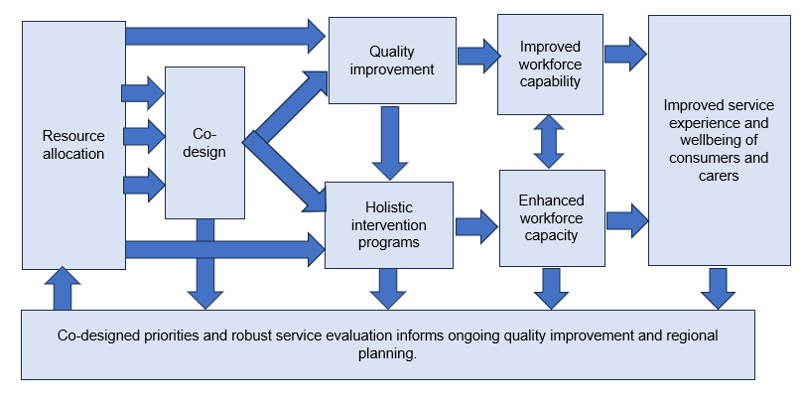
Impacting policy and practice

